Slide 1
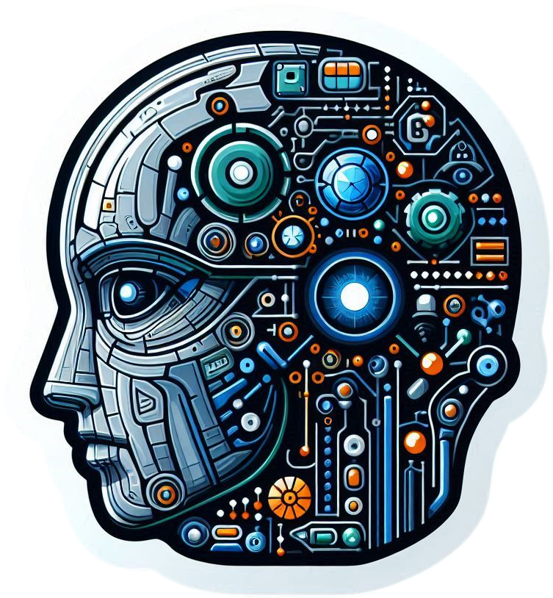
Artificial Intelligence: The Power of Learning
Artificial intelligence (AI) is when a computer can learn from information and make choices without needing specific instructions. AI systems are taught using large sets of data to find patterns, predict what will happen, and solve difficult problems.

Slide 2
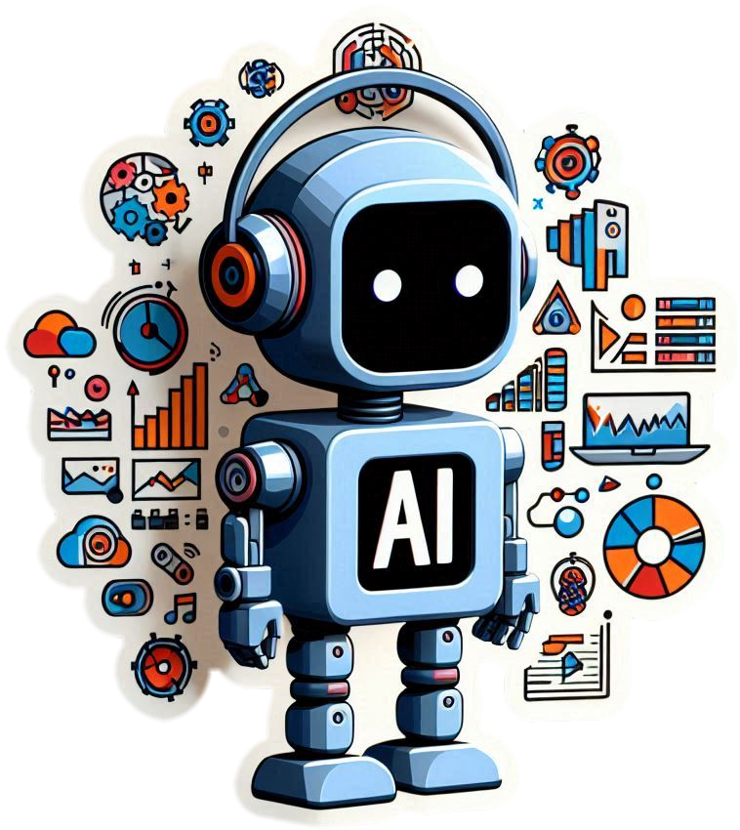
How ChatGPT and Gemini Models Work?
ChatGPT and Gemini are large language models (LLMs) trained on massive datasets of text and code. They use deep learning algorithms to understand and generate human-like text, translate languages, write different kinds of creative content, and answer your questions in an informative way.

Slide 3
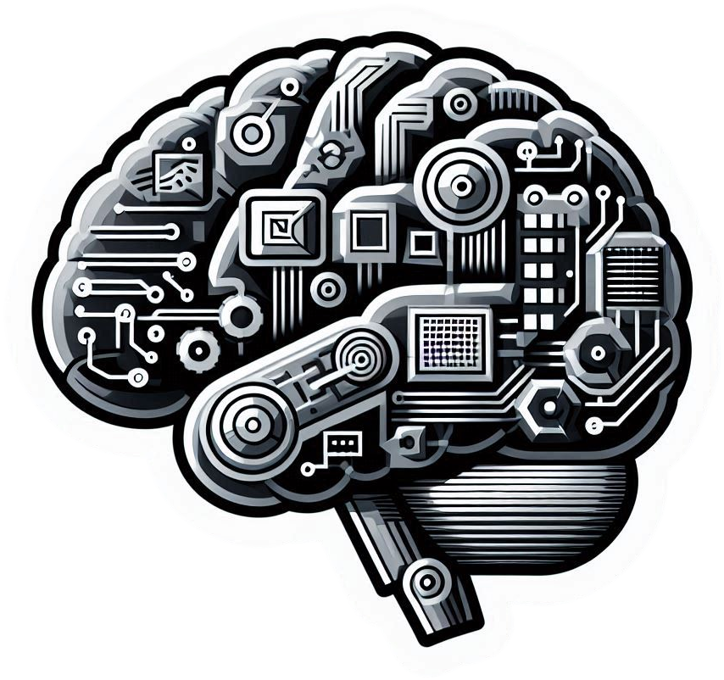
Supervised and Unsupervised Learning: Understanding the Differences
Machine learning can be broadly classified into supervised and unsupervised learning. These approaches differ in their training data, learning goals, and the types of tasks they are designed to handle.

Slide 4
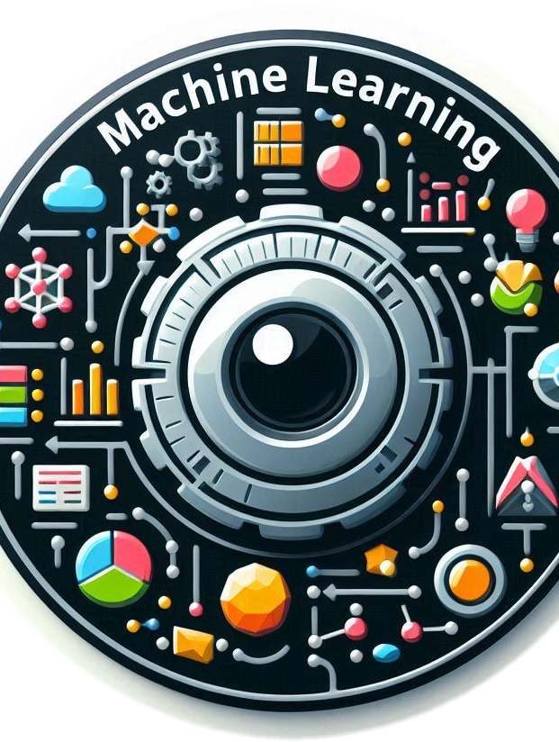
What is a Classifier?
In the realm of machine learning, a classifier is a function that predicts the class or category of a given data point. These functions are trained on labeled data, learning to distinguish between different categories based on patterns and relationships within the data.

Slide 5
Done by: Deekonda Laxmi Pranathi.

